Slide 1
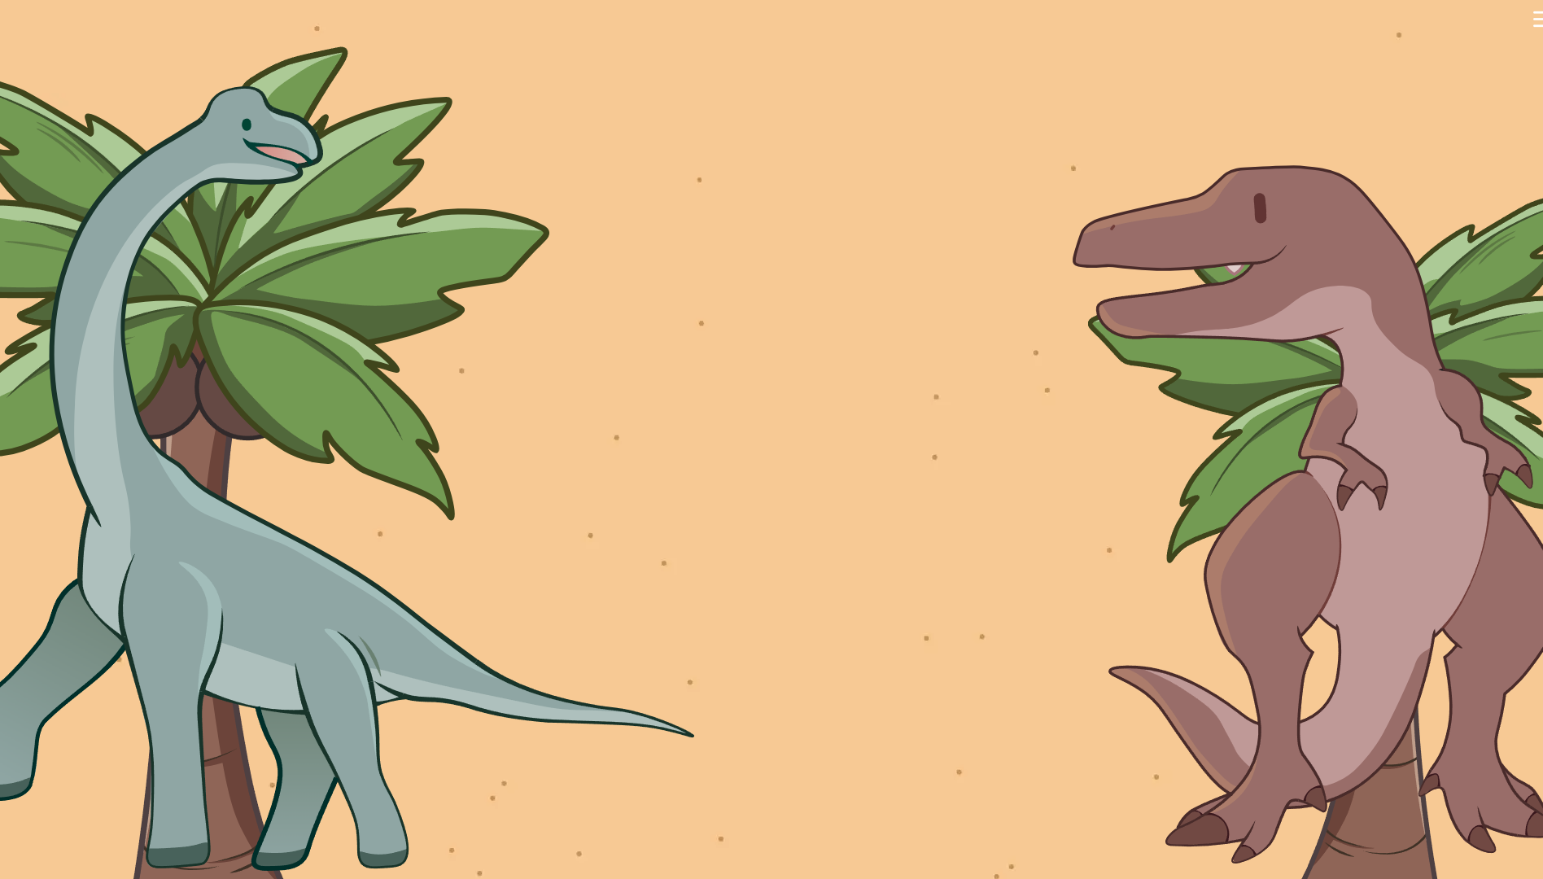
ShellHacks: Dino Mail
2
+
Jonah Turrell, Anna Zheng,
Haley Bae, Kayla Pham

Slide 2
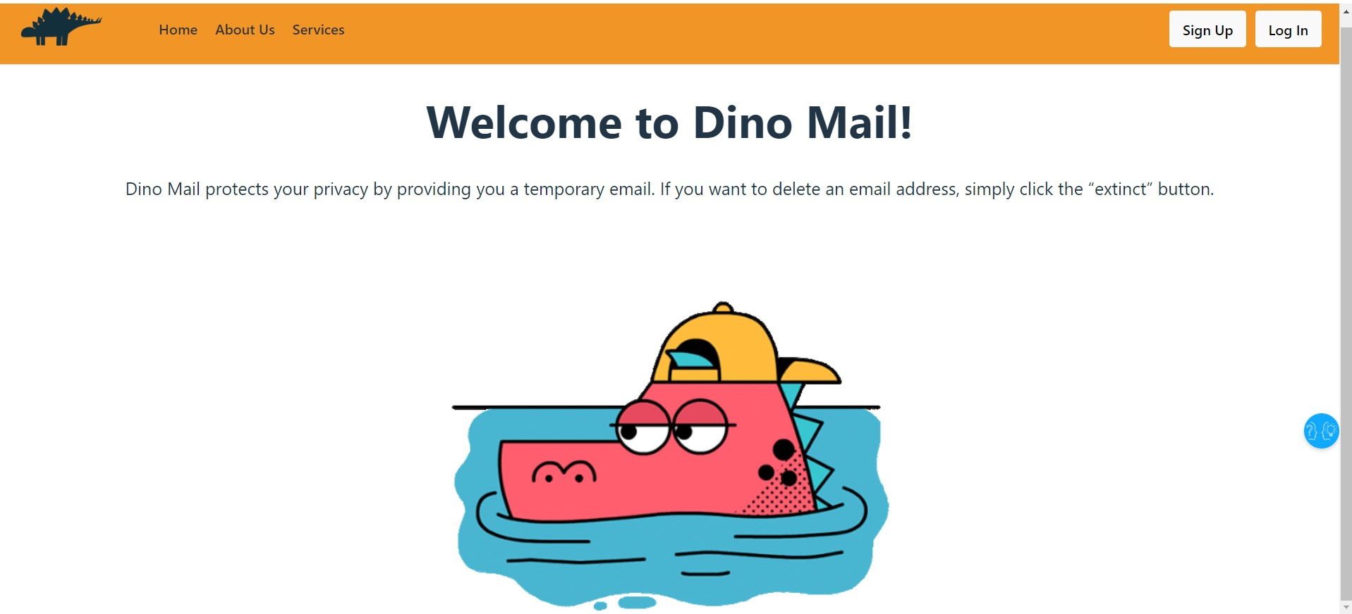
2
+
WHAT IT IS
A disposable email website that provides users a temporary email address.

Slide 3

FRONTEND
BACKEND
React
Figma
HTML / CSS / JavaScript
NodeJS
Dovecot
BASH

Slide 4


CHALLENGES
2
+
2
+
Database
Getting everything to display properly
Automating deployment

Slide 5

ACCOMPLISHMENTS
2
+
Creating an aesthetically pleasing website, especially being our first.
Shellhacks' timeframe with a team of 100% first-time hackers.
Teamwork and new technologies.

Slide 6

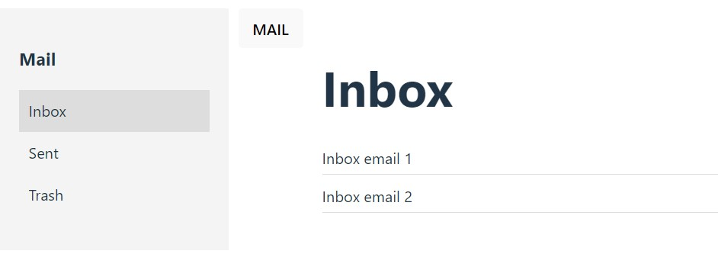
FUTURE INTEGRATION
2
+
2
+
Database for add / delete management.
Making deployment to a server easier.
Bugs and additional features.

Slide 7
THANK YOU
2
+

